Slide 1
MBA607A STAGE 1
JIVAN CARE
GROUP 9-
Ayush Yadav (200256)
Vishnu Gaur (201132)
Divyansh Gupta (200351)
Sanskriti Sharma (200876)
Jayesh Lakade (200475)

Slide 2
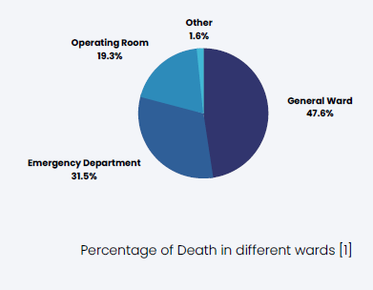
DEFINING THE BUSINESS
Health monitoring device- It is a device that continuously reads the vitals of patients which can be monitored by the medical staff in real-time. In case a patient's health deteriorates, automated alerts are sent to the doctors.
The patient is admitted to the hospital but is left unattended due to the shortage of nurses. Due to lack of a proper monitoring system, deterioration in patient's health goes unnoticed. The patient gets attention after his condition goes out of control. If there was a better monitoring system and enough number of nurses, a life could be saved. Reports show that most of these deaths happen in the general ward.

Slide 3
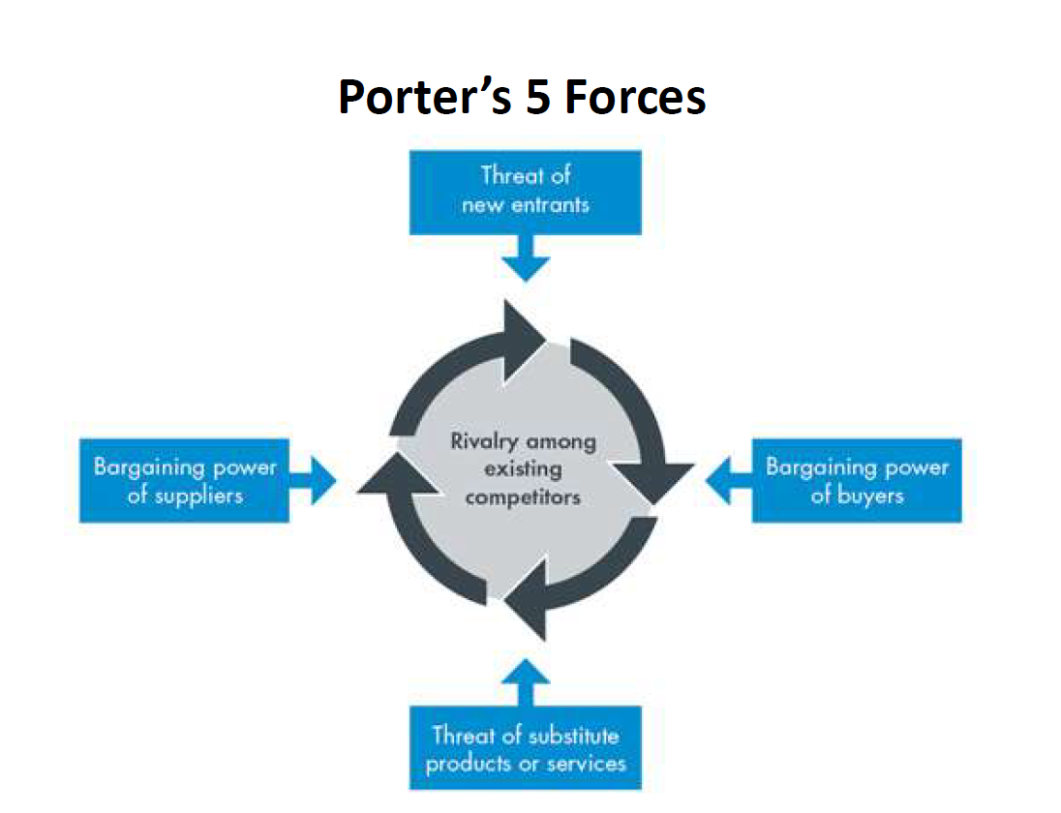
Philips’ Patient Monitoring Device, TSC group- Sensium, VitalConnect- VitalPatch
We will use multiple suppliers for sensors, batteries
We will be selling it to hospitals and clinics and other competitors are well established

Slide 4
PESTEL Analysis
Political
Indian government’s ABHA plan will be a major factor for the growth of our business as the data of the patients would be easily accessible by other hospitals so that the past medical history of the patient would be easily available.
Economical
Interest rates, credit availability and inflation are economic factors that affect healthcare industry performance and operation. These Economic environment changes can greatly influence the spending policies of companies and purchase behavior of consumers.
Social
Sense of safety among the patient's family, Improved working condition for medical staff, Patients at home are as safe as those in hospital, Saving lives in rural areas etc

Slide 5
Technology
As technology is modifying day by day and new and improved sensors are coming in the market, so investing more into R&D can affect both costs and competitive advantage. Data obtained from the device can be further used for research purposes and it will act as a revenue generating factor by selling it to data driven healthcare companies.
Environmental-
The materials used for making all these parts are primarily eco-friendly and positively impact the environment. Most of them are non-hazardous and can be easily recycled. Few components like wrist-wrap and finger wraps can be reused in new devices.
Legal
We had passed almost all medical test but still government can pose us to take other test which will be legal threat for us.

Slide 6
Strengths
Weaknesses
Opportunities
Threats
The utilities provided will help monitor vitals & predict deterioration of patient’s condition & provide details to doctors on a easy-to-use user friendly app.
Liabilities and deaths in Hospitals due to human negligence and improper monitoring will be greatly reduced
End to End encrypted so personal data of a person will be secured
As most of our gadget work on electricity so if some place do not have proper electric supply, then our gadget won’t work.
Batteries that we are using are lithium ion batteries which are environmental friendly but they are very costly
As covid had striked so people at house also started taking care of their family members in near future we can go households
Upcoming health monitoring watches as well as such sensor may lead to threat for our business

Slide 7
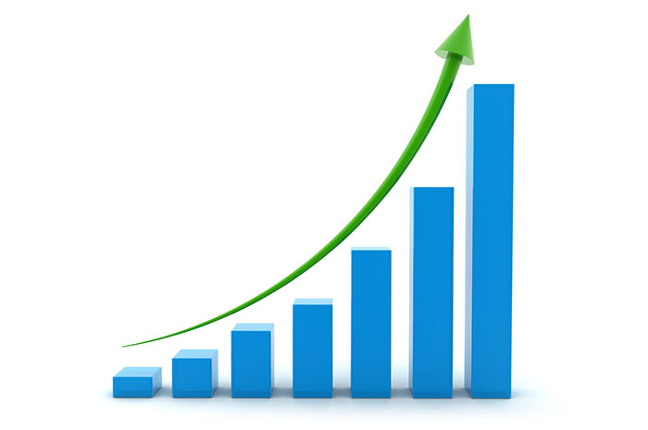
GROWTH IN THE INDUSTRY
Since we will offer our product to the hospitals and to the general public. So, for maximising the reach of the product will do advertisements via hospitals that are using our product, will conduct hospital camps and showcase our device in healthcare innovation exhibitions. Word of mouth by the general public who have used our product will also play an important role in the growth of the industry.
According to our initial analysis our revenue in the 1st year would be around 1.2 crores and in the second year it will increase to around 14 crores as we have examined the growth in number of units sold of 45,000 units.

Slide 8
Marketing mix : 4Ps
Product
Secure
Convenient
Reliable
Easy to use
Promotion
Word of mouth
Government encouraged
Advertised in news
Place
Portable
Easily available
Price
Cheap as compared to the competitors
Scope of increasing price

Slide 9
TAM-SAM-SOM
TOTAL AVAILABLE MARKET- The number of people with medical issues(especifically elderly people) which is approximately 6.8% of the population of India and all the Hospitals and Clinics in India.
SERVICABLE AVAILABLE MARKET- Tier 1 and Tier 2 Hospitals in Metropolitan Cities having better facilities and people in low-middle income group and above in the area.
SERVICABLE OBTAINABLE MARKET- 3% of the available market in india in 1st year and 10% in the 2nd, due to competitors like Philips, VitalConnect, TSC group etc.

Slide 10
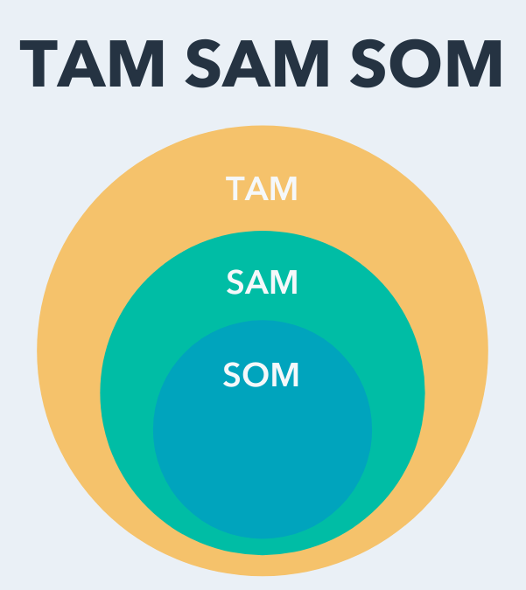
Total Available Market-
People with medical issues and Hospitals and clinics in india.
Serviceable Available Market-
Hospitals and Clinics in Metropolitan Cities with better facilities and People in low-middle income group and above.
Serviceable Obtainable Market-
3% of available market in 1st year and 10% in the 2nd year.

Slide 11
Investment needed with the amount and timing of those funds needed
Investment needed-
Manufacturing Plant location (5 acre)- rent cost- 4 million/year
Machines- 10 million
Warehouse- 2 million/ year
Working Capital- 20 Million/ month
Advertising cost- 3 Million/ year
R&D cost - 2 million
Testing cost- 3.5 million
Initial investment Total- 264.5 Million for first year

Slide 12
Formulating the 'Articles of Association' for filing with the Registrar of Companies
NAME
The name of the company is JIVAN AADHAR .
OBJECTIVE
Provide better healthcare monitoring for the all the citizens of india and provide all the citizens of India with a digital health ID that will facilitate easy access to medical records.

Slide 13
BOARD OF DIRECTORS
The company shall have a board of directors consisting of 5 directors. The first directors of the company are
Ayush Yadav
Vishnu Gaur
Sanskriti sharma
Divyansh Gupta
Jayesh O Lakade . The directors shall hold office until the next annual general meeting of the company, at which time they shall retire, and their successors shall be elected.
POWERS OF THE BOARD OF DIRECTORS
The board of directors shall have the power to manage and conduct the affairs of the company and to exercise all the powers and authorities vested in the company, subject to the provisions of the Companies Act and these Articles.

Slide 14
DIRECTORS' MEETINGS
Meetings of the board of directors may be called by any director, and notice of such meetings shall be given to all directors. A quorum for a meeting of the board of directors shall be 3. Each director shall have one vote, and decisions shall be made by a majority of votes.
CHAIRMAN OF THE BOARD
The Chairman of the Board shall be elected by the directors from among themselves. In the absence of the Chairman, the directors present shall elect a chairman for the meeting.
DISSOLUTION
In the event of the dissolution of the company, any remaining assets shall be distributed between the board of directors, as determined by the board of directors.

